Slide 1
WELCOME

Slide 2

DEVELOPMENT OF SMART SYSTEM FOR RUNOFF MEASUREMENT
Presented by:
Kaneriya Parth B. Under the guidance of
(Reg. No. 3050216041) Dr. H.D. Rank
Rupareliya Nikunjkumar Professor and Head
(Reg. No. 3050216073) Department of Soil &
Vanra Dhavalkumar Water Conservation
(Reg. No. 3050216091) Engineering.
COLLEGE OF AGRICULTURAL ENGINEERING AND TECHNOLOGY
JUNAGADH AGRICULTURAL UNIVERSITY
JUNAGADH – 362 001

Slide 3
CONTENTS
INTRODUCTION
REVIEW OF LITERATURE
MATERIALS AND METHODS
RESULTS AND DISCUSSION
SUMMARY AND CONCLUSIONS
REFERENCES

Slide 4
INTRODUCTION

Slide 5
INTRODUCTION
Runoff is the draining away of water from the surface of an area of land or structure
Runoff is part of water cycle that flow over land as surface water instead of being absorbed into groundwater or evaporating
Type of Runoff :-
Mainly, There are three type of runoff,
Surface Runoff
Subsurface Runoff
Ground water flow

Slide 6
( continue..)
Surface runoff is water flows over the land and is first to reach the streams or river which ultimately discharge the water to the sea
Subsurface runoff is a part of rainfall which first leaches into the soil and move laterally without joining the water table to stream, river or ocean
Ground water flow is a portion which after infiltrate percolate down and joins the ground water reservoir which is ultimately connected to ocean

Slide 7
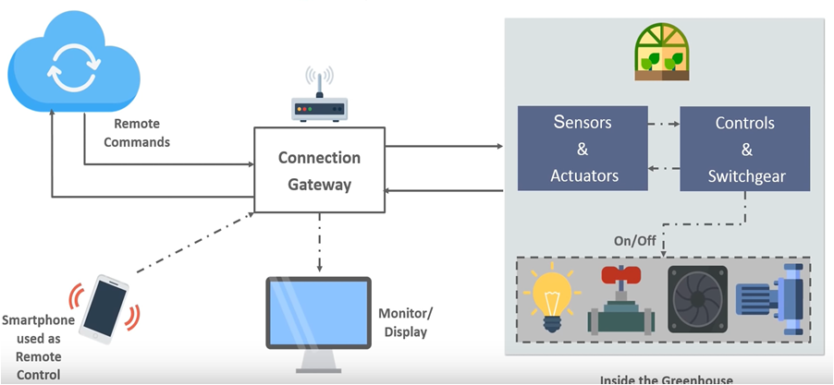
( continue..)
IoT mean internet of things
IoT is simply the network of interconnected things or devices which are embedded with sensors, software, network connectivity and necessary electronics that enables them to collect and exchange data making them responsive
CONCEPT OF IoT

Slide 8
IoT architecture and working:
( continue..)
- The architecture of IoT is also known as four-stage architecture,
Stage 1:- includes the sensors and the actuators
Raw data is collected by the sensors from the surrounding from an object and is converted into the useful data
An actuator acts according to the changes in the physical environment
The data can be processed by the sensors

Slide 9
( continue..)
Stage 2 :- includes the aggregation systems and analog-to-digital converter
The data which is collected by the sensors in analog form. It is converted into digital format using data acquisition systems (DAS) for future processing.
The DAS performs analog to digital conversions along with data aggregation.
The Internet gateway receives this aggregated and digitized data and provides routing for it over the wireless or wired network.
The analog data requires specialized software for processing based on timings and structures.

Slide 10
( continue..)
Stage 3:- processing of the data is done by some technology
The data enters the third stage after digitization and aggregation for more processing.
This processing is performed by the IT systems through detailed analysis. These IT systems may be at off-site or at on-site.
Stage 4 :- data is moved to the data center systems
It is the final stage the data is stored at the data centers and cloud.
This data is transferred to data centers which have more advanced IT systems to perform in-depth analysis.
This type of processing particularly takes place on the location.

Slide 11
( continue..)
Runoff plots are used to measure surface runoff under controlled conditions. We developed a smart system for measurement of runoff using concept of IoT
Ultrasonic sensors with microcontroller can be used as depth measuring device in runoff tanks
These sensors record the raw data and communicate with micro-controller in order to generate the actual depth using various functions
The processed data is sent to the Wi-Fi modules by communication protocols in order to provide remotely access to data
This Wi-Fi module works as an internet gateway and sends sensor data to webpage. The webpage and cloud is used for data visualizations and data storing purposes. These data can be further used for analysis.

Slide 12
Justification:
( continue..)
we can measure peak runoff rate by using smart runoff measurement system, it will help to design different hydrologic structure
Rainfall-Runoff relationship is also most important for different irrigation storage structure . we can measure Runoff depth by this system
Also in at night time, adverse condition of climate we can measure the data at pre decide time interval

Slide 13
OBJECTIVES
To develop the IoT based smart automatic runoff measurement system
To evaluate the performance of developed smart automatic runoff measurement system
To develop the computer program to communicate and store data on cloud through IoT and WiFi module

Slide 14
REVIEW OF LITERATURE

Slide 15
REVIEW OF LITERATURE
Design and development of any system need the background knowledge
The studied reviews include runoff measurement and automation by use of IoT
Runoff
IoT in Agriculture
Ultrasonic sensor
I2C communication
Web application

Slide 16
Authors | Findings
Stewart et al. ( 2014 ) | Developed a new instrument to measure plot scale runoff They developed an low-cost and reliable instrument to measure runoff Upwelling Bernoulli Tube (UBeTube) instrument is a pipe with a slot machined in its side that is install vertically at the base of a runoff collection system The UBeTube device is used in long-term rainfall -runoff study, it has ability of the instrument to measure surface runoff across a range of flow and conditions

Slide 17
Authors | Findings
Mohanraj et al. (2016) | Studied on Field Monitoring and Automation using I0T in Agriculture Domain Agriculture sector in India They found that for making profitable decisions, farmers need information throughout the entire farming cycle Monitoring modules are used various sensors for collection different environmental data. They comparatively studied between the developed system and the existing systems. The system overcomes limitations of traditional agricultural procedures by utilizing water resource efficiently and also reducing labour cost.

Slide 18
Authors | Findings
Panda et al. (2016) | Studied the Effects of environment on accuracy of ultrasonic sensor operates in millimeter range. They discussed different environmental parameters which have the major influence on the accuracy of the ultrasonic sensor They formulate a simplified mathematical equation to calculate instantaneous speed of sound by taking different influencing parameters into consideration. Comparison result shows the derived simplified equation for calculating instantaneous speed of sound gives maximum percentage error of 0.33 for the temperature range of 0-50˚C. They mainly focus on the steps to calibrate ultrasonic sensor for millimeter range of operation.

Slide 19
Authors | Findings
Kaith et al. ( 2016) | Reported that an implementation of Inter Integrated Circuit (I2C) protocol for slave module for no data loss. They introduce the principle and the operation of I2C bus protocol. It follows the I2C specification to provide device addressing, read/write operation and an acknowledgement. They demonstrated how I2C Master Controller transmits and receives data to and from the Slave with proper synchronization for no data loss

Slide 20
Authors | Findings
Hemlata Channe et al. (2018) | Developed multidisciplinary model for smart agriculture using Internet-of-Things, sensors, cloud-computing, mobile-computing & big-data analysis. Used of Mobile App module to collect information about Farmers, Agro Marketing agencies and Agro-Vendors which is stored in Agro cloud . Soil and environment properties are sensed and periodically sent to Agro Cloud through IoT. Big data analysis on Agro Cloud data is used to estimate amount of fertilizer requirements, total production, current stock, market requirements and best crop sequences analysis Suggested model that is beneficial for increase in agricultural production and for cost control of Agro-products

Slide 21


Slide 22
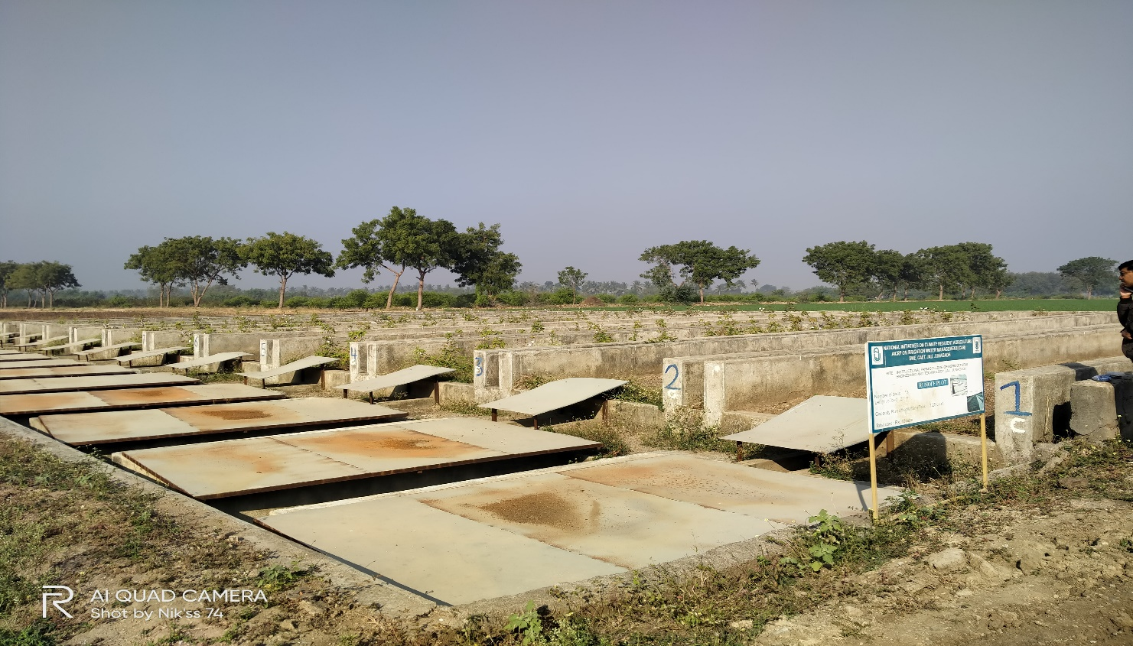
Description Of Study Area:
( continue..)
Location :-
Instructional Farm, Department of Soil and Water Engineering, College of Agricultural Engineering and Technology, JAU, Junagadh
The location is situated in South Saurashtra agro climatic zone of Gujarat state.
Sr no
1 | East Longitude | 69.40° to 71.05°
2 | North Latitude | 20.44° to 21.40°
3 | elevation | 83 m above MSL (Mean Sea Level)

Slide 23
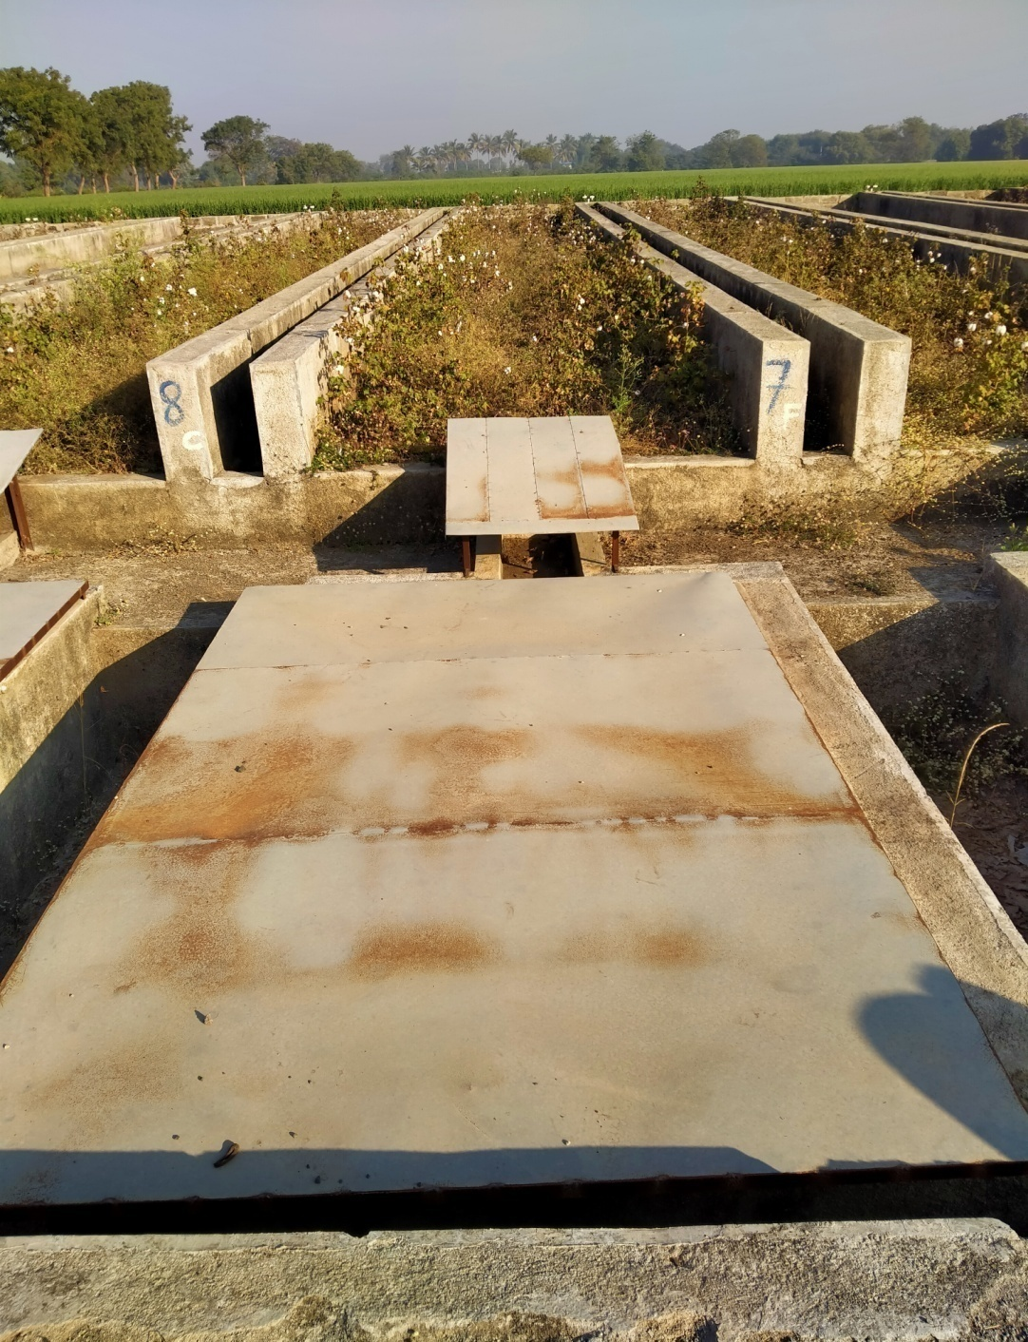
Runoff plot :-
( continue..)
At the end of each runoff bed runoff guiding masonry ways having 1/6 th width of runoff bed for guiding runoff water from runoff bed to runoff collecting tank were constructed.
Therefore the runoff diverted from runoff bed n collecting tank was considered 1/6" of total runoff from each bed.
The runoff tanks and water ways were covered with metallic sheet to prevent addition of direct rainfall into actual runoff water coming from bed.
Specification of runoff plot
Length of each bed | 22.3 m
Width of each bed | 2.5 m.
Area of each bed | 55.75 m
Height of masonry wall | 0.6 m
Size of runoff collection tank | 1.7 m x 3.25 m x 0.75 m.

Slide 24
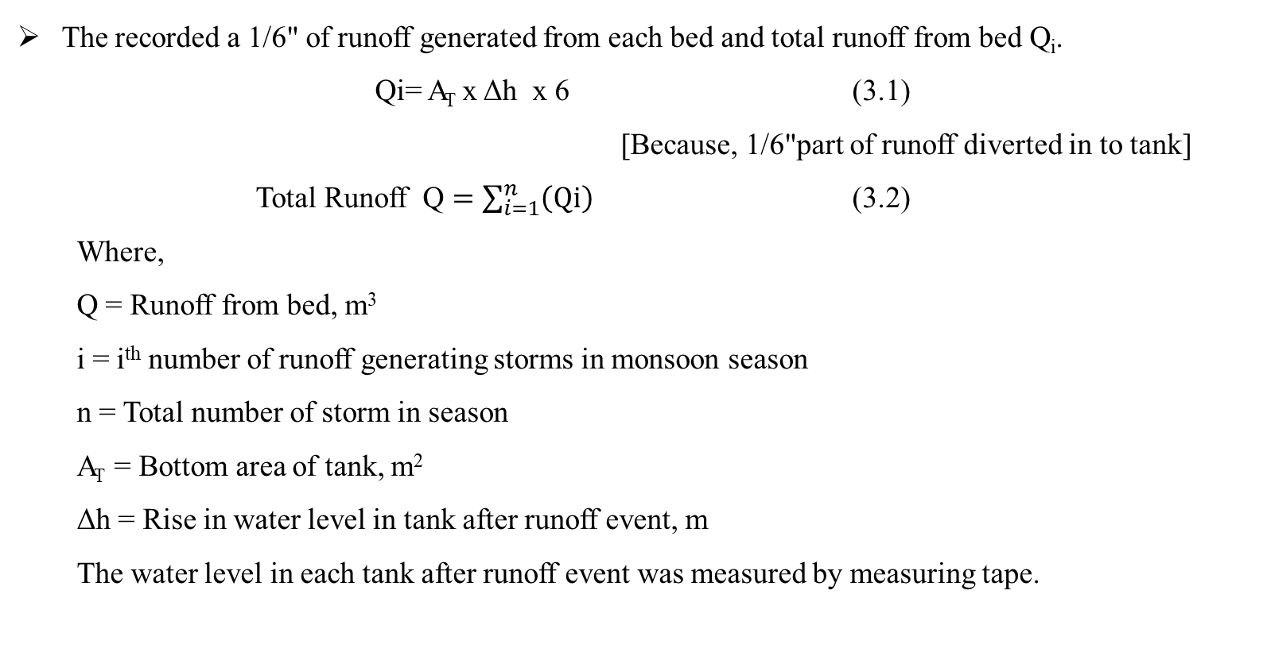
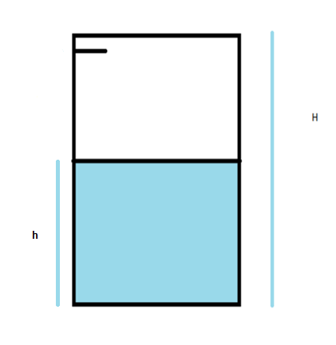
Measurement Of Runoff :
( continue..)
Runoff tank

Slide 25
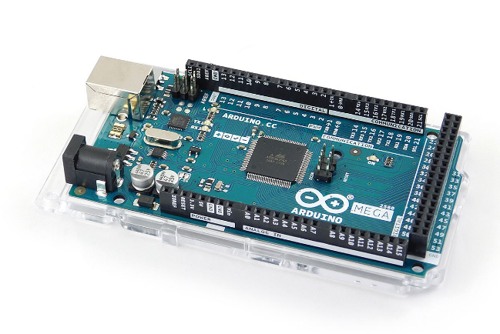
Smart Runoff Measurement System Hardware :
Arduino Mega 2560 :
The Arduino Mega is a microcontroller board based on the ATmega2560.
54 digital input/output pins
16 analog inputs
16 MHz crystal oscillator
USB connection
power jack
ICSP header
reset button
Microcontroller | ATmega2560
Operating Voltage | 5V
Input Voltage (recommended) | 7-12V
Input Voltage (limit) | 6-20V
Digital 1/0 Pins | 54 (of which 15 provide PWM output)
Analog Input Pins | 16
DC Current per 1/O Pin | 20 mA
DC Current for 3.3V Pin | 50 mA
Flash Memory | 256 KB of which 8 KB used by bootloader
SRAM | 8 KB
EEPROM | 4 KB
Clock Speed | 16 MHz
LED BUILTIN | 13
Length | 101.52 mm
Width | 53.3 mm
Weight | 37g
It can be simply connect to a computer with a USB cable or power it with a AC-to-DC adapter or battery to get started.

Slide 26
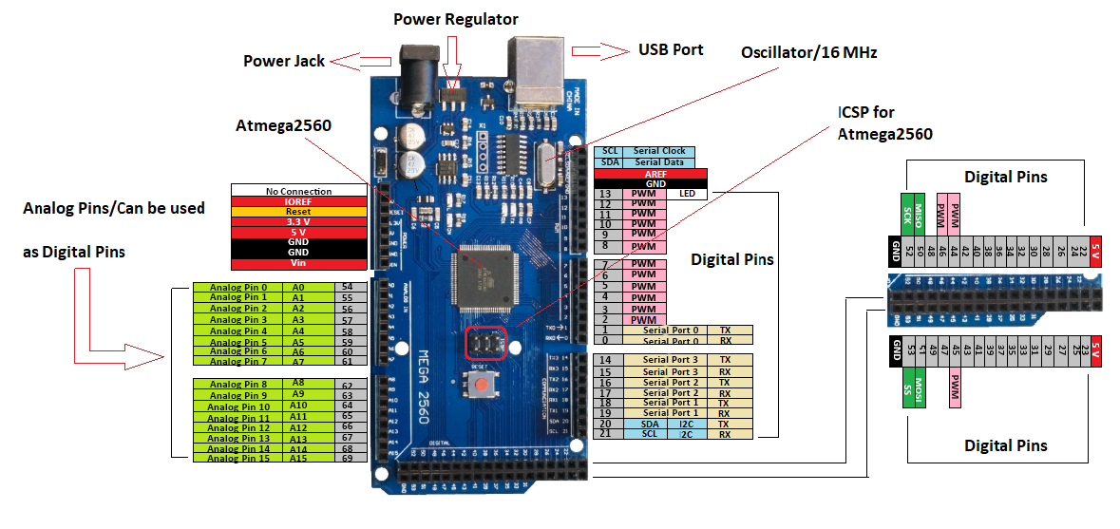
Arduino Mega 2560 Pin Configuration
( continue..)

Slide 27
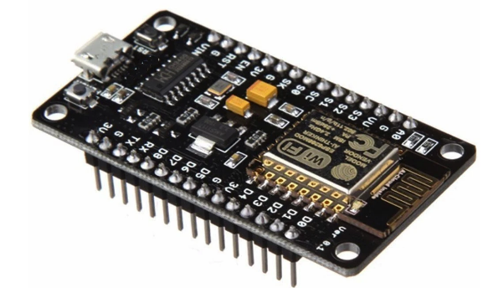
Wi-Fi Module:
The NodeMCU (Node Micro Controller Unit) is an open source software and hardware development environment that is built around a very inexpensive System-on-a-Chip (SoC) called the ESP8266.
This small module used to allow microcontroller to connect to a Wi-Fi network and make simple TCP/IP connection using Hayes-style commands
Specification of NodeMCU
Operating system | XTOS
CPU | ESP8266
Memory | 128kBytes
Strorage | 4MBytes
Power By | USB
Power Voltage | 3v ,5v
IDE Used | Arduino IDE
GPIO | 10

Slide 28
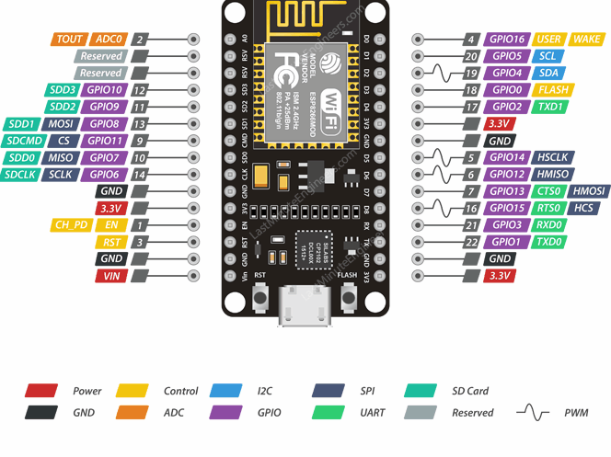
ESP8266 NodMCU Pin Configuration
( continue..)

Slide 29
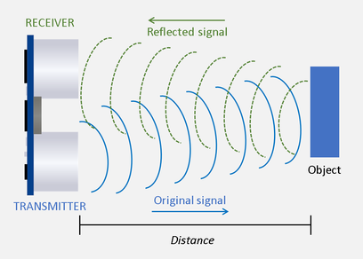
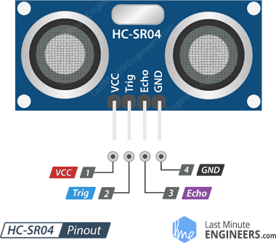
Ultrasonic Sensor :
( continue..)
The HC-SR04 Ultrasonic Distance Sensor capable of measuring the distance between itself and the nearest object.
An Ultrasonic Transmitter – This transmits the ultrasonic sound pulses, it operates at 40 KHz
An Ultrasonic Receiver – The receiver listens for the transmitted pulses. If it receives them it produces an output pulse whose width can be used to determine the distance the pulse travelled.
Operating Voltage | DC 5V
Operating Current | 15mA
Operating Frequency | 40KHz
Max Range | 4m
Min Range | 2cm
Ranging Accuracy | 3mm
Measuring Angle | 15 degree
Trigger Input Signal | 10µS TTL pulse
Dimension | 45 x 20 x 15mm

Slide 30
Calculation for distance measurement :
( continue..)
Distance = speed * Time
The speed of sound wave is 343 m/s
Total distance = 343 * time of high (Eco) pulse / 2
Total distance is divide by 2 because signal travels from HC – SR04 to object and return to the module HC-SR04

Slide 31
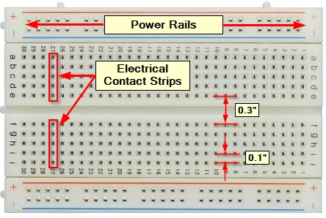
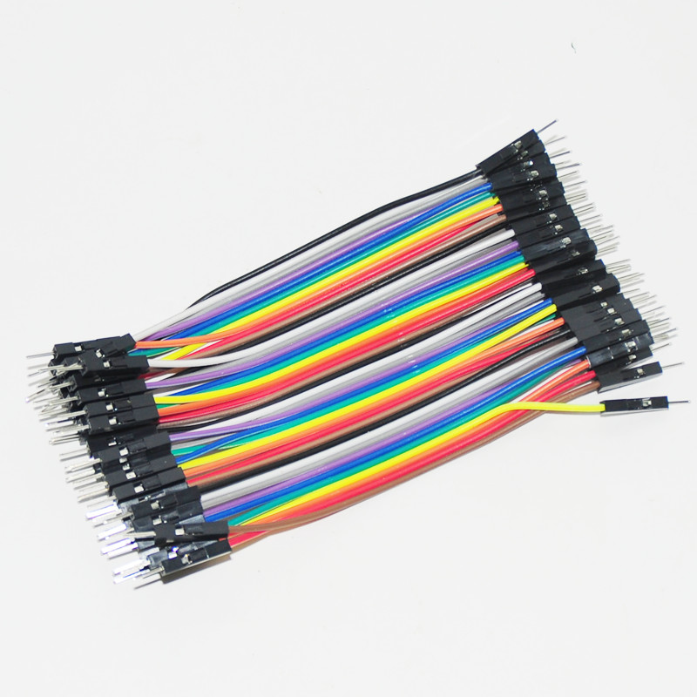
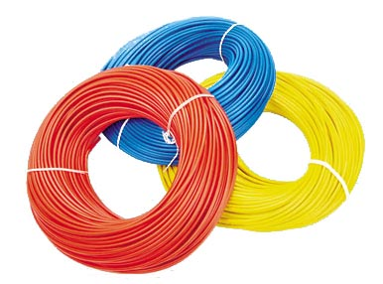
Breadboard :
It is solderless device for temporary prototype with electronics and Test circuit designs. Most electronic components in electronic circuit can be Interconnected by inserting their leads or terminals into the holes and then making connection through wires where appropriate.
Wire :
Jumper wire: It is electrical wire or group of them in a cable, with a connector or pin at each end which normally used to interconnect the components of bread board without soldering.
Single core wire: It is also electrical wire having single core metal thread. It is used for connecting sensors and micro controller which are far away from each other.

Slide 32
Software Used :
( continue..)
Arduino IDE:
Arduino IDE (Integrated Development Environment) is official software introduced by Arduino.cc that is mainly used for writing, compiling and uploading the code in the Arduino Device.
It is open source and is readily available to install.
The main code, also known as a sketch, created on the IDE platform will ultimately generate a Hex File which is then transferred and uploaded in the controller on the board.
This environment supports both C and C++ languages.

Slide 33
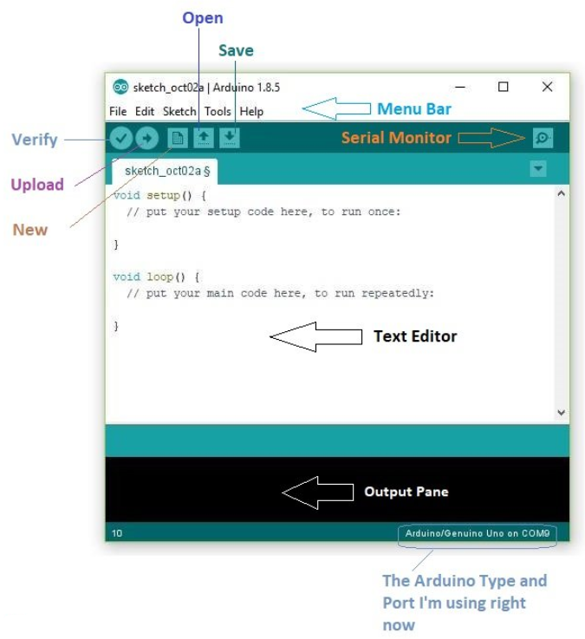
The IDE environment is mainly distributed into three sections:
1. Menu Bar
2. Text Editor
3. Output Pane
1 . Menu bar
The bar appearing on the top is called Menu Bar that comes with five different options:
File – open a new window for writing the code
Edit – Used for copying and pasting the code
Sketch – For compiling and programming
Tools – open a new window for writing the code
Help – complete help is available from getting started to troubleshooting.
( continue..)
Arduino IDE Software

Slide 34
( continue..)
2. Text Editor
The main screen below the Menu bar is known as a simple text editor used for writing the required code.
3. Output Pane
The bottom of the main screen is described as an Output Pane that mainly highlights the compilation status of the running code: the memory used by the code, and errors occurred in the program. You need to fix those errors before you intend to upload the hex file into your Arduino Module.

Slide 35
Structure Of Arduino Sketch :
( continue..)
Arduino sketch consists of two mandatory functions known as setup() and loop() functions.
SETUP() FUNCTION :
This function is only executed once every time that sketch is run and it will start it’s execution of instruction present in it once it has been programmed in our Arduino board. It can be re-run by using reset button.
LOOP() FUNCTION :
Statements present in loop () function will continuously run from top to bottom and then back to top. The operational functionality of Arduino takes place in loop () function.

Slide 36
Arduino Libraries Used :
( continue..)
NewPing :
The NewPing library is quite advanced and it considerably improves upon the accuracy of our original sketch. It also supports up to 15 ultrasonic sensors at once and it can directly output in centimeters, millimeters, inches or time duration. It won’t lag for a full second when no echo is received and it has a built-in median filter.
Wire Library :
This library allows you to communicate with I2C / TWI devices. On the Arduino boards with the R3 layout (1.0 pinout), the SDA (data line) and SCL (clock line) are on the pin headers close to the AREF pin.

Slide 37
Arduino Libraries Used :
( continue..)
3. ESP8266WiFi :
The Wi-Fi library for ESP8266 has been developed based on ESP8266 SDK, using the naming conventions and overall functionality philosophy of the Arduino Wi-Fi library. This library allows a nodeMCU board to connect to the internet. It can serve as either a server accepting incoming connections or a client making outgoing ones.

Slide 38
I2C Serial Communication :
( continue..)
The I2C communication bus is very popular and broadly used by many electronic devices because it can be easily implemented in many electronic designs which require communication between a master and multiple slave devices.
The easy implementations comes with the fact that only two wires are required for communication between up to almost 128 (112) devices when using 7 bits addressing and up to almost 1024 (1008) devices when using 10 bits addressing.
I2C is a serial communication protocol, so data is transferred bit by bit along a single wire (the SDA line).

Slide 39
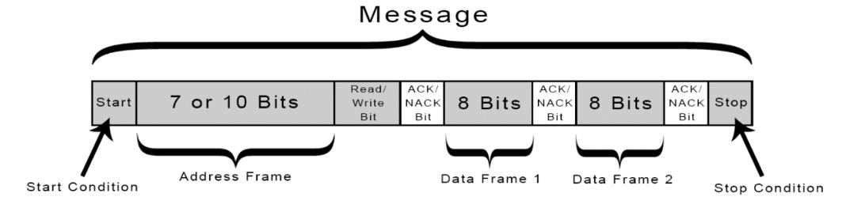
Working of I2C :
( continue..)
Each device has a preset ID or a unique device address so the master can choose with which devices will be communicating.
With I2C, data is transferred in messages. Messages are broken up into frames of data. Each message has an address frame that contains the binary address of the slave, and one or more data frames that contain the data being transmitted.
The message also includes start and stop conditions, read/write bits, and ACK/NACK bits between each data frame.

Slide 40
Power Unit:
( continue..)
Solar energy can be used to meet our electricity requirements.
Through solar photovoltaic (SPV) cells, solar radiation gets converted into DC electricity directly.
This electricity can either be used as it is or can be stored in the battery.
solar power systems consist of a core set of components
Solar Panels
Batteries
Charge Controllers

Slide 41
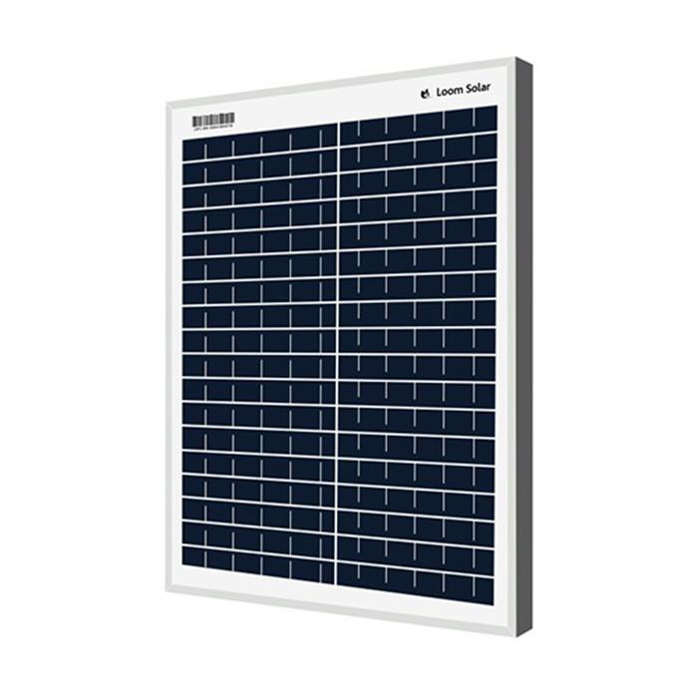
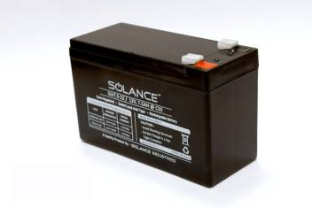
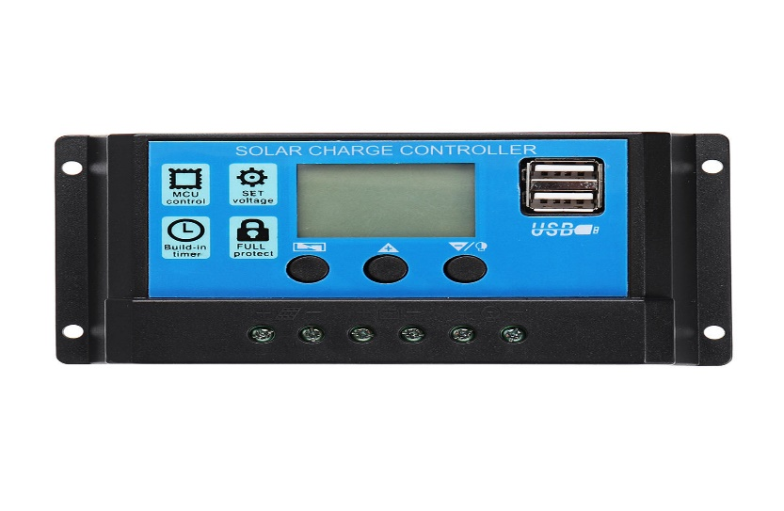
Solar Panel
A solar panel is a collection of solar cells, The solar panel converts the solar energy into electrical energy
Solar Battery
Solar Battery is used to store power which is generate by Solar Panel which is used further.
Solar Charge Controller
A charge controller is an essential part of nearly all power systems that charge batteries Whether the power source is PV, wind, hydro, fuel or utility grid
Charge controllers block reverse current and prevent battery overcharge.
Protect from electrical overload and display battery status and the flow of power

Slide 42
Solar PV system sizing:
( continue..)
Determine power consumption demands :
Power = Voltage x Current
Now power requirement for:
-Arduino Mega 2560
Output current = 200mA
Output voltage= 12 volt
Output wattage = 0.2 * 12 = 2.4 W
-NODEMCU- ESP8266
Output current = 120 mA
Output voltage= 5 volt
Output wattage = 0.12 * 5 = 0.6 W
Power Requirement = 2.4 + 0.6 = 3 W
Total PV Panel energy needed =1.3 * 3 = 3.9 W

Slide 43
( continue..)
Size the PV modules :
To find out the sizing of PV module, the total peak watt produced needs
The peak watt (Wp) produced depends on size of the PV module and climate of site location
For our experiment power requirement is 3.9 W
So, we can use the 10 watt and 12 volt solar panel to full fill over requirement

Slide 44
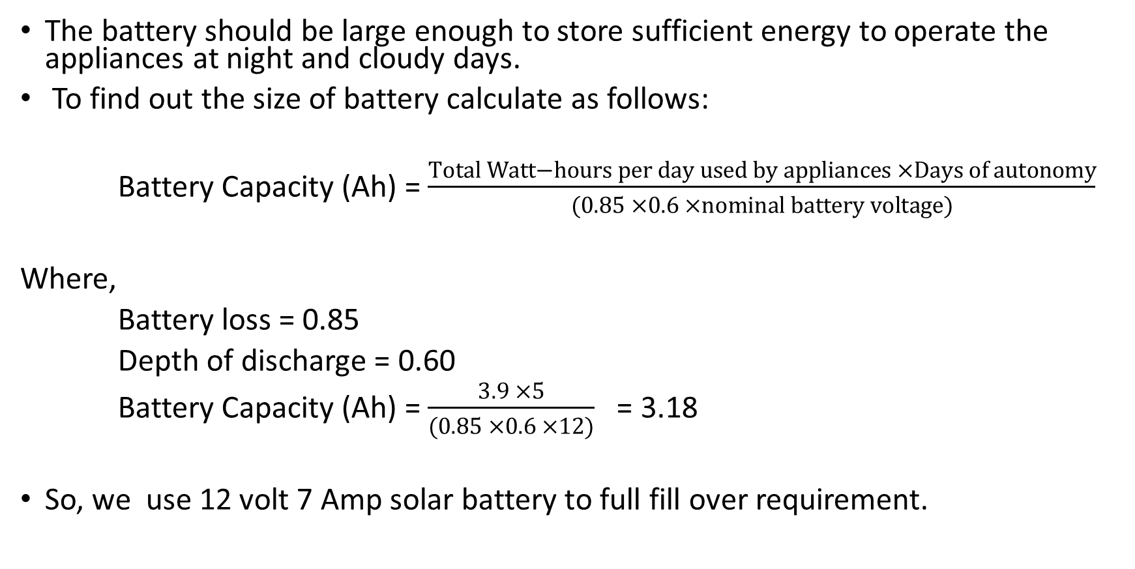
Size of Battery :
( continue..)
The battery should be large enough to store sufficient energy to operate the appliances at night and cloudy days.
To find out the size of battery calculate as follows:
Battery Capacity (Ah) = $\frac{Total Watt−hours per day used by appliances ×Days of autonomy}{(0.85 ×0.6 ×nominal battery voltage)}$
Where,
Battery loss = 0.85
Depth of discharge = 0.60
Battery Capacity (Ah) = $\frac{3.9 ×5}{(0.85 ×0.6 ×12)}$ = 3.18
So, we use 12 volt 7 Amp solar battery to full fill over requirement.

Slide 45
Selection of solar charge controller :
( continue..)
The solar charge controller is typically rated against Amperage and Voltage capacities.
Select the solar charge controller to match the voltage of PV panel and batteries and then identify which type of solar charge controller is right for your application.
Make sure that solar charge controller has enough capacity to handle the current from PV array.
As per our solar panel and battery specification, we select 12 V-24 V, 10A solar charge controller.

Slide 46
RESULTS AND DISCUSSIONS

Slide 47
RESULTS AND DISCUSSIONS
This chapter deals to develop a smart runoff measurement system for a measurement of runoff depth and send data to webpage for storing and visualization
The observed data were analyzed to evaluate the performance of ultrasonic sensors and the results obtained are discussed in this chapter.

Slide 48
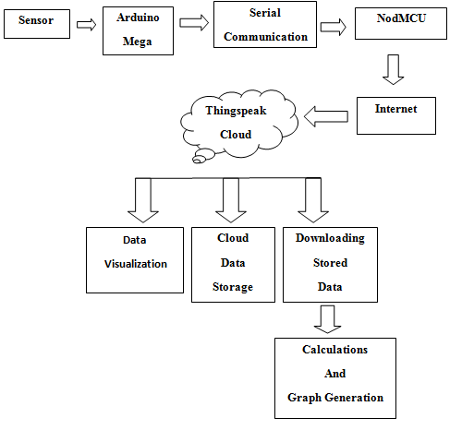
Smart Runoff Measurement System:
( continue..)
Flow chart

Slide 49
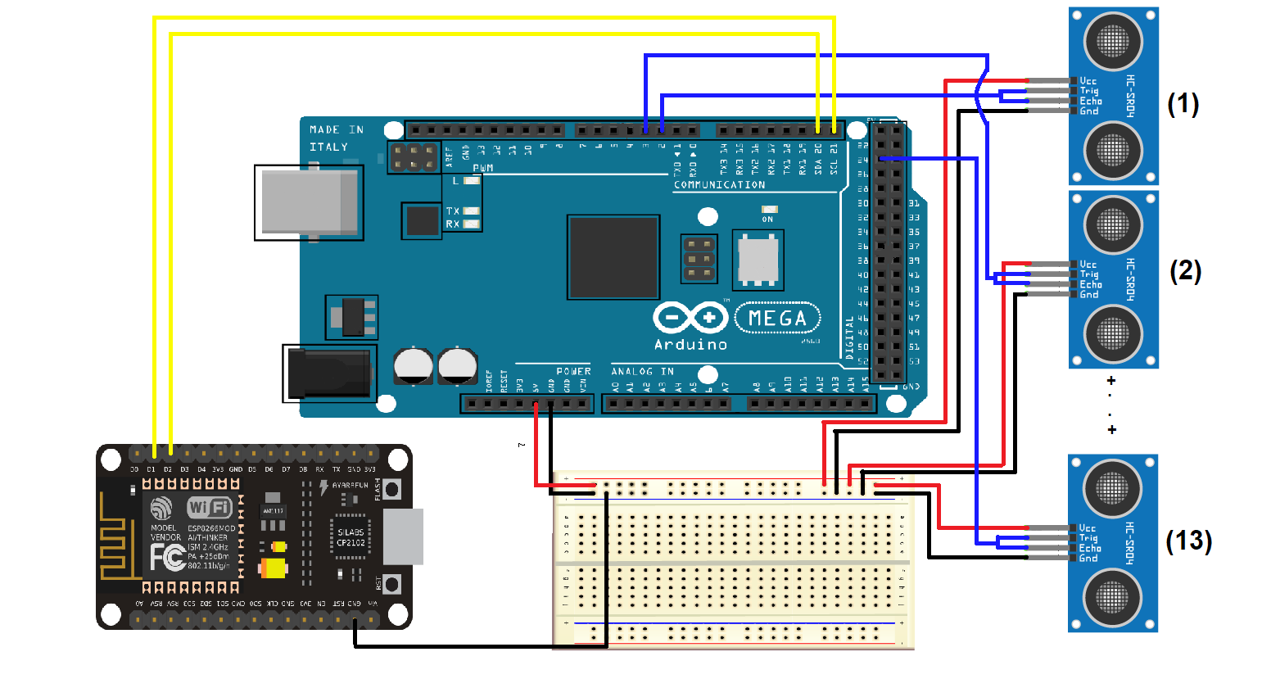
Connection Diagram Of Smart Runoff Measurement System:
( continue..)
Circuit diagram

Slide 50
( continue..)
Arduino Mega | NodeMCU | Work
SDA | D2 | Serial Data Line
SCL | D1 | Serial Clock Line
Gnd | Gnd | Ground Line
Arduino Mega | Ultrasonic Sensors | Work
5 V | VCC | Power Line
D2 to D13,D22* | Trig | Activate Transmitter for Ultrasonic Pulses.
D2 to D13,D22* | Echo | Activate Receiver for listen Ultrasonic Pulses.
Gnd | Gnd | Ground Line
Table : Pin configuration of different components of smart runoff measurement system

Slide 51
Validation of Ultrasonic Sensor :
( continue..)
We programmed ultrasonic sensor by three different methods,
Using New Ping Library
Using New Ping Library and Iterations
Using New Ping Library and Temperature Effect Equation

Slide 52
1)By New Ping Library Method :
( continue..)

Slide 53
Sr. No. | Sensor Reading(mm) | Manual Reading(mm) | Absolute Error(mm) | Relative Error(%)
1 | 680 | 680 | 0 | 0
2 | 650 | 656 | 6 | 0.91
3 | 623 | 630 | 7 | 1.11
4 | 600 | 605 | 5 | 0.82
Mean Error |  |  | 4.5 | 0.71
Table: The manual measured and sensor measured runoff depth using new ping library
From Table,
Mean absolute error = 4.5 mm
Relative error = 0.71%.

Slide 54
( continue..)
2) New Ping Library with Iterations method:

Slide 55
Sr. No. | Sensor Reading(mm) | Manual Reading(mm) | Absolute Error(mm) | Relative Error(%)
1 | 566 | 570 | 4 | 0.7
2 | 544 | 550 | 6 | 1.09
3 | 527 | 530 | 3 | 0.56
4 | 507 | 515 | 8 | 1.55
Mean Error |  |  | 5.25 | 0.97
Table: The manual measured and sensor measured runoff depth using new ping library with Iterations method
From Table,
Mean absolute error =5.25 mm
Relative error = 0.97%.

Slide 56
3) New Ping Library with Temperature Effect Equation Method:
( continue..)
Temperature is also parameter that affects the speed of sound
In high temperature molecules vibrate faster, sound waves can travel more quickly
For ultrasonic sensors, variation in temperature is result in a stationary target appear closer or farther away
Equation of speed of sound:
V = (331.296 + [0.606 × T])
Where, V = Speed of sound (m/sec)
T = Temperature of Air (°C)

Slide 58
Sr. No. | Sensor Reading(mm) | Manual Reading(mm) | Absolute Error(mm) | Relative Error(%)
1 | 487 | 490 | 3 | 0.61
2 | 468 | 470 | 2 | 0.42
3 | 455 | 460 | 5 | 1.08
4 | 443 | 445 | 2 | 0.44
Mean Error |  |  | 3 | 0.63
Table: The manual measured and sensor measured runoff depth using new ping library with Temperature Effect Equation
From Table,
Mean absolute error =3 mm
Relative error = 0.63%.

Slide 59
Third Party Website for Data Storage & Visualization:
( continue..)
We used Thingspeak.com as a third party platform for data storage and visualization
It is open source platform made for IoT device, developers and learners where developers can
send and log data to the server
Analyses
retrieve and store results using graphs with matlab support
To send data to things peak we need something called API key from our account which needs to be inserted in the program code.

Slide 60
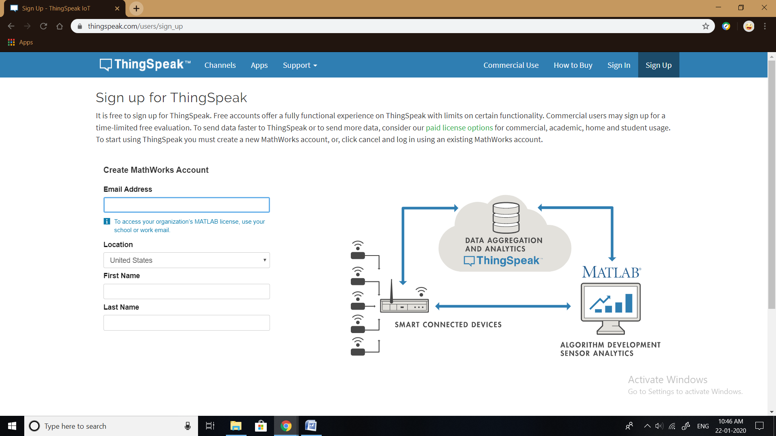
ThingSpeak Basics and Account Setup:
Sign Up for account and create channel

Slide 61
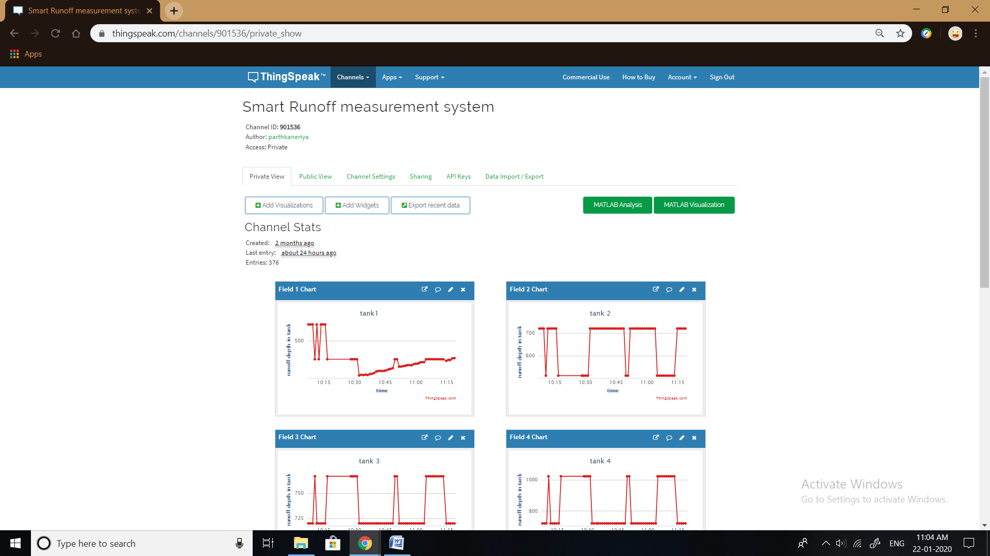
Channel & API Keys:
Create channel “ smart runoff measurement system” with channel ID: 901536

Slide 62
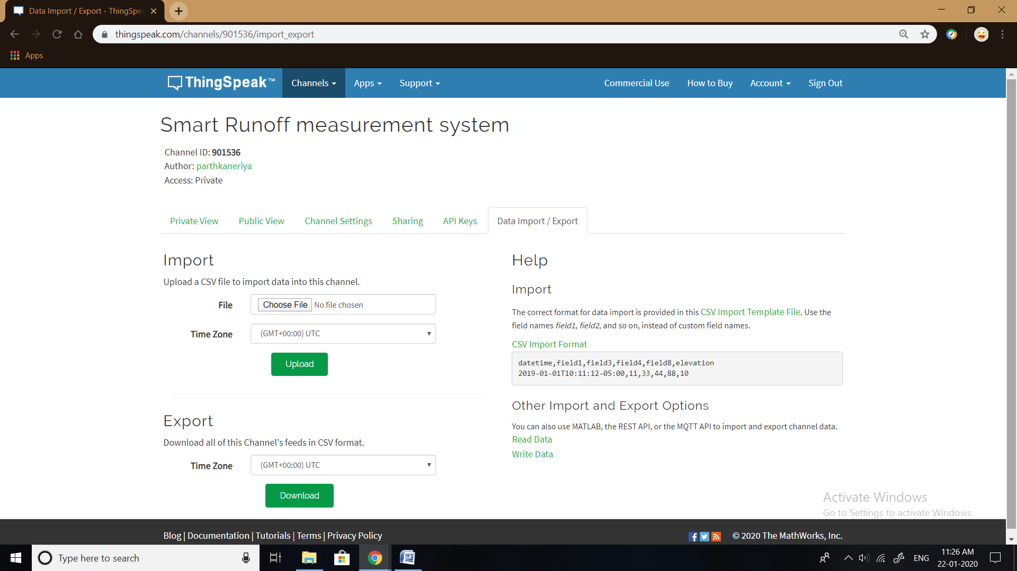
Data Downloading:

Slide 63
SUMMARY
AND
CONCLUSION

Slide 64
Summary and Conclusion
Estimation of peak runoff rate is very important for design of hydrological structure.
Estimation of runoff volume or runoff depth is one of the design parameters for irrigation storage structure
Runoff plot is used for estimation of runoff volume and peak runoff rate
Sometimes, this runoff plot is structured at remote location.
It is very difficult to measure runoff depth in adverse weather condition and at night time. Smart Runoff measurement system is very useful in this type of condition.

Slide 65
( continue..)
The following conclusions were derived from the outcomes obtained through the development and evaluation of smart runoff measurement system:
The IoT based developed smart runoff measurement system can be very cost effective and efficient system for the monitoring the runoff
The runoff data can be directly stored in cloud storage and obtained at our place for the further processes
By using NewPing Library mean absolute error and relative error is 4.5 mm and 0.71% of distance measured respectively
By using NewPing Library with iteration method mean absolute error and relative error is 5.25 mm and 0.97% of distance measured respectively
By using NewPing Library with temperature effect equation method mean absolute error and relative error is 3 mm and 0.63% of distance measured respectively
So, From above discussion it is recommended to use NewPing Library with temperature effect equation method to measure distance using ultrasonic sensor.

Slide 66
REFERENCES

Slide 67
Ritter, Michael E. 2006. The Physical Environment, an Introduction to Physical Geography, Prentice Hall. U.K.
Oza, K.P. 2018 Effect of different cropping pattern on runoff and soil loss for junagadh region. M. Tech. thesis, CAET, JAU, Junagadh, Gujarat, India.
Sherman and Mockus V. 1949. Estimation of total (and peak rates of) surface runoff for individual storms. Exhibit an in Appendix B, Interim Survey Report (Neosho) River Watershed USDA, Washington DC.
Wendt. R. C.; Alberts, E. E. and Hjelmfelt, A. T. 1986. Variability of runoff and soil loss from fallow experimental plots. Soil Science Society of America Journal. 50(3): 730-736.
Balvanshi, A. and Tiwari, H. L. 2014. A comprehensive review of runoff estimation by the curve number method. International Journal of Innovative Research in Science, Engineering and Technology. 3: 432-438.
Chaudhary, A.; Mishra, S. K. and Pandey A. 2013. Experimental verification of the effect of slope on runoff and curve numbers. Journal of Indian Water Resource Soc. 33(1): 40-46.

Slide 68
R. D. Stewart.; Z. Liu2.; D. E. Rupp3.; C. W. Higgins2. and J. S. Selker2. 2014 A new instrument to measure plot-scale runoff. Published in Geosci. Instrum. Method. Data Syst.
J. S. Cao.; W. J. Zhang. and Y. Q. Qi. An automatic slope runoff system sediment and flow monitoring system. Applied Engineering in Agriculture Vol. 30(1): 5-9
Li J. Gu W.; Yuan H. (2016) Research on 1OT Technology Applied to Intelligent Agriculture. In: Huang B Yao Y (eds) Proceedings of the 5th International Conference on Electrical Engineering and Automatic Control. Lecture Notes in Electrical Engineering vel 367 Springer Berlin Heidelberg
Mohanraj I*a .; Kirthika Ashokumarb. and Naren Jc. 2016. Field Monitoring and Automation using IOT in Agriculture Domain. Procedia Computer Science vol.93:931-939
Kirtan Gopal Panda.; Deepak Agrawal.; Arcade Nshimiyimana. and Ashraf Hossain. 2016 Effects of environment on accuracy of ultrasonic sensor operates in millimeter range. Department of Electronic and Communication Engineering, National Institute of Technology, Silchar, Assam, India.

Slide 69
THANK You

